Slide 1
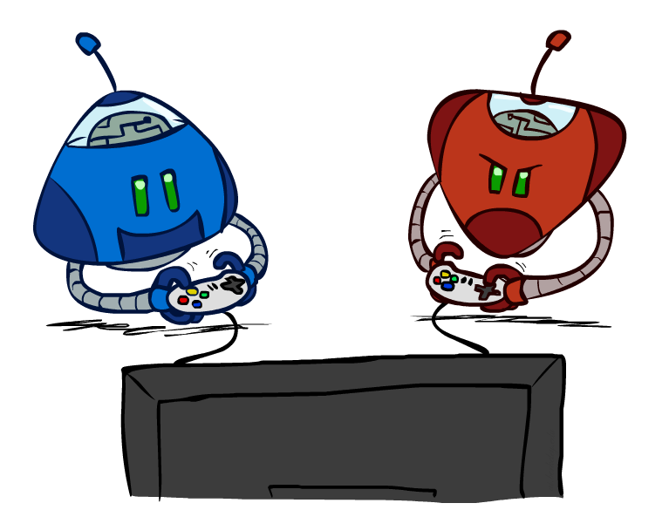
CS 188: Artificial Intelligence
Games: Minimax and Alpha-Beta
Instructors: Stuart Russell and Dawn Song
University of California, Berkeley
Notes:
Please retain proper attribution and the reference to ai.berkeley.edu. Thanks!

Slide 2
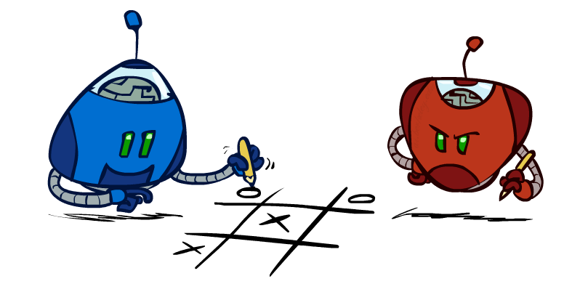
Outline
History / Overview
Minimax for Zero-Sum Games
α-β Pruning
Finite lookahead and evaluation

Slide 3
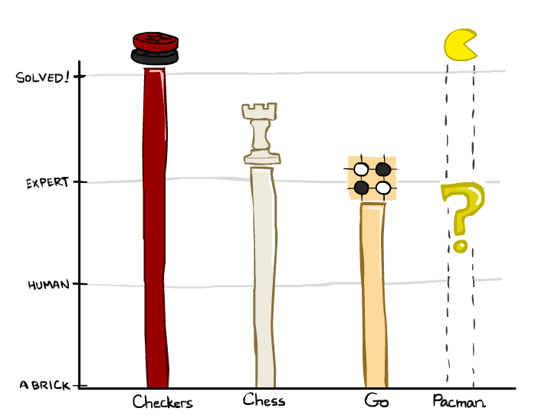
A brief history
Checkers:
1950: First computer player.
1959: Samuel’s self-taught program.
1994: First computer world champion: Chinook defeats Tinsley
2007: Checkers solved! Endgame database of 39 trillion states
Chess:
1945-1960: Zuse, Wiener, Shannon, Turing, Newell & Simon, McCarthy.
1960s onward: gradual improvement under “standard model”
1997: Deep Blue defeats human champion Garry Kasparov
2022: Stockfish rating 3541 (vs 2882 for Magnus Carlsen 2015).
Go:
1968: Zobrist’s program plays legal Go, barely (b>300!)
1968-2005: various ad hoc approaches tried, novice level
2005-2014: Monte Carlo tree search -> strong amateur
2016-2017: AlphaGo defeats human world champions
Pacman
Notes:
Tinsley lost only 5 games to humans in 42 years; has been known to solve 60-ply problems

Slide 4
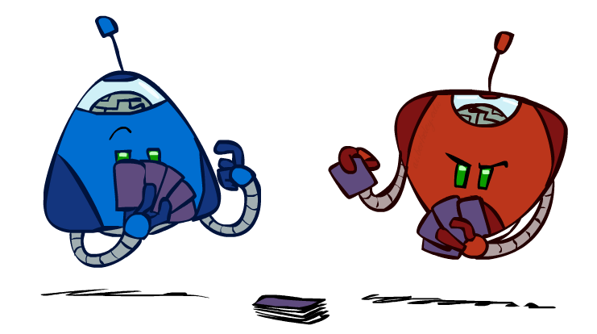
Types of Games
Game = task environment with > 1 agent
Axes:
Deterministic or stochastic?
Perfect information (fully observable)?
Two, three, or more players?
Teams or individuals?
Turn-taking or simultaneous?
Zero sum?
Want algorithms for calculating a contingent plan (a.k.a. strategy or policy) which recommends a move for every possible eventuality

Slide 5
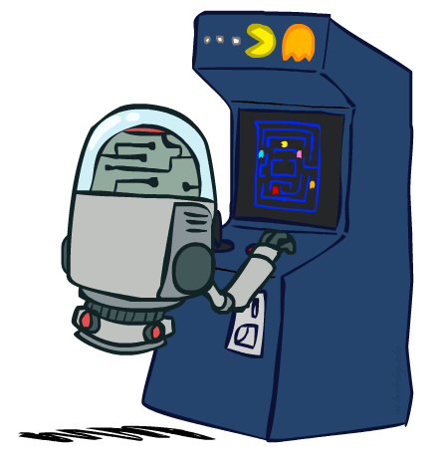
“Standard” Games
Standard games are deterministic, observable, two-player, turn-taking, zero-sum
Game formulation:
Initial state: s₀
Players: Player(s) indicates whose move it is
Actions: Actions(s) for player on move
Transition model: Result(s,a)
Terminal test: Terminal-Test(s)
Terminal values: Utility(s,p) for player p
Or just Utility(s) for player making the decision at root

Slide 6
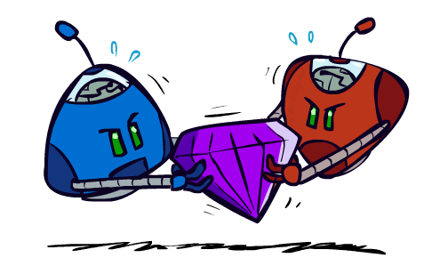
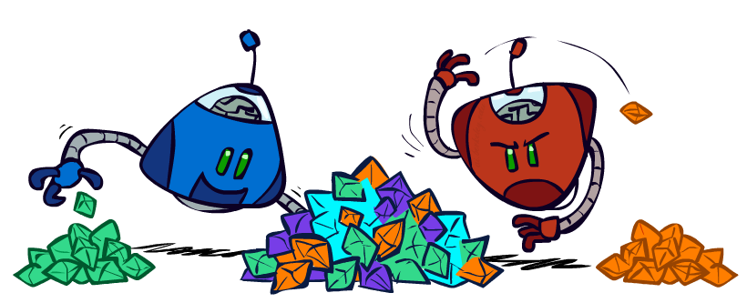
Zero-Sum Games
Zero-Sum Games
Agents have opposite utilities
Pure competition:
One maximizes, the other minimizes
General-Sum Games
Agents have independent utilities
Cooperation, indifference, competition, shifting alliances, and more are all possible
Team Games
Common payoff for all team members

Slide 7
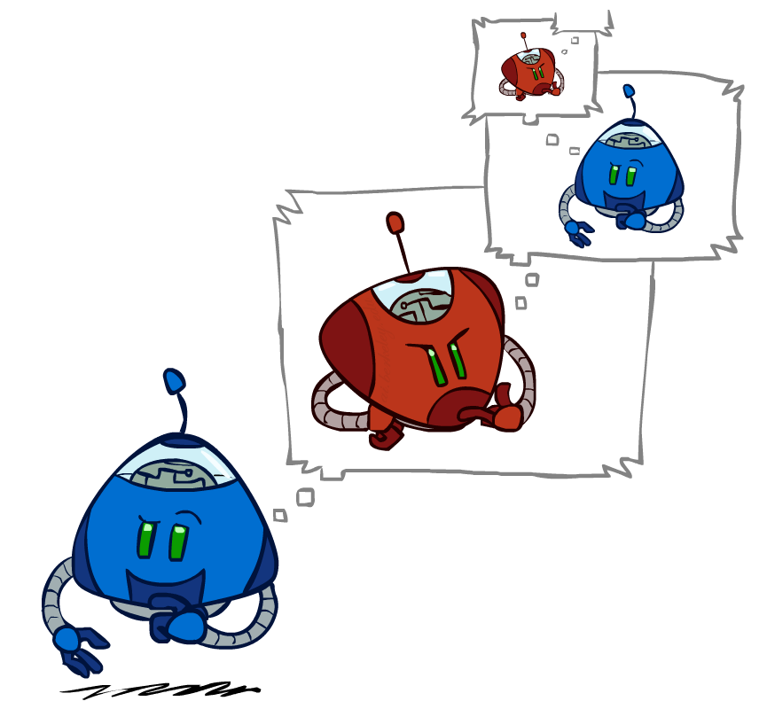
Adversarial Search

Slide 8
Single-Agent Trees
8
2
0
…
2
6
…
4
6
Notes:
10 points for eating dot; -1 for each time step

Slide 9
Value of a State
Value of a state: The best achievable outcome (utility) from that state
Non-Terminal States:
V(s) = max V(s’)
s’ ∈ successors(s)
8
2
0
…
2
6
…
4
6
Terminal States:
V(s) = known

Slide 10
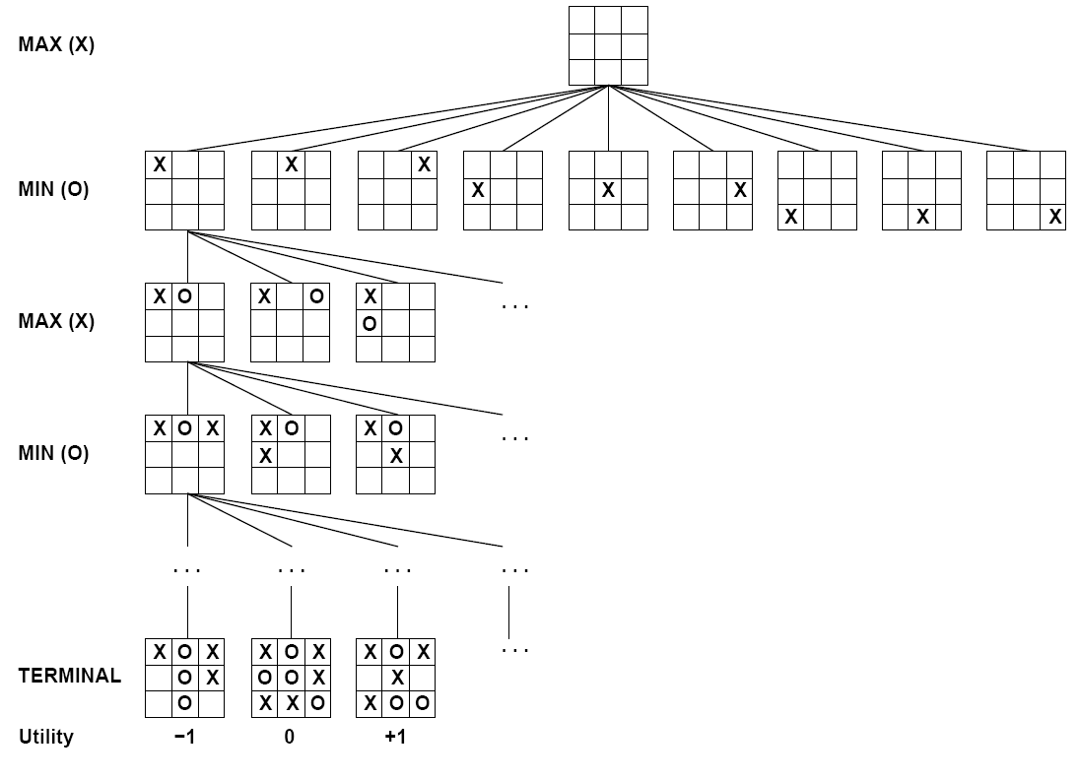
Tic-Tac-Toe Game Tree

Slide 11
Minimax Values
MAX nodes: under Agent’s control
V(s) = max V(s’)
MIN nodes: under Opponent’s control
V(s) = min V(s’)
s’ ∈ successors(s)
s’ ∈ successors(s)
-8
-8
-10
-8
-5
-10
+8
Terminal States:
V(s) = known

Slide 12
Minimax algorithm
Choose action leading to state with best minimax value
Assumes all future moves will be optimal
=> rational against a rational player

Slide 13
Implementation
function minimax-decision(s) returns an action
return the action a in Actions(s) with the highest minimax_value(Result(s,a))
function minimax_value(s) returns a value
if Terminal-Test(s) then return Utility(s)
if Player(s) = MAX then return max_{a in Actions(s)} minimax_value(Result(s,a))
if Player(s) = MIN then return min_{a in Actions(s)} minimax_value(Result(s,a))

Slide 14
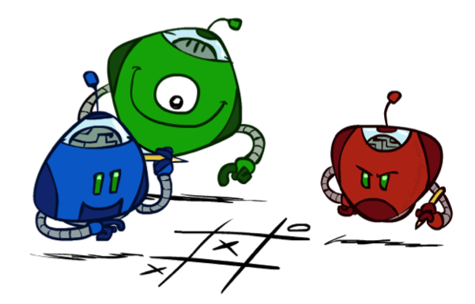
Generalized minimax
What if the game is not zero-sum, or has multiple players?
Generalization of minimax:
Terminals have utility tuples
Node values are also utility tuples
Each player maximizes its own component
Can give rise to cooperation and
competition dynamically…
8,8,1
8,8,1
7,7,2
0,0,7
8,8,1
7,7,2
0,0,8
1,1,6
0,0,7
9,9,0
8,8,1
9,9,0
7,7,2
0,0,8
0,0,7
Notes:
If both ghosts go the same way, pacman wins; if they go different ways, pacman loses

Slide 15
Emergent coordination in ghosts
Notes:
Two ghosts equipped with minimax: pacman gets his head handed to him. EVAL includes closeness to pacman, but final surrounding move due to terminal states.
This could be done with two-ghost state but is actually a three-player minimax with both ghosts using min; i.e., coordination emerges (usually!)

Slide 16
Minimax Efficiency
How efficient is minimax?
Just like (exhaustive) DFS
Time: O(b^{m})
Space: O(bm)
Example: For chess, b ≈ 35, m ≈ 100
Exact solution is completely infeasible
Humans can’t do this either, so how do we play chess?

Slide 17
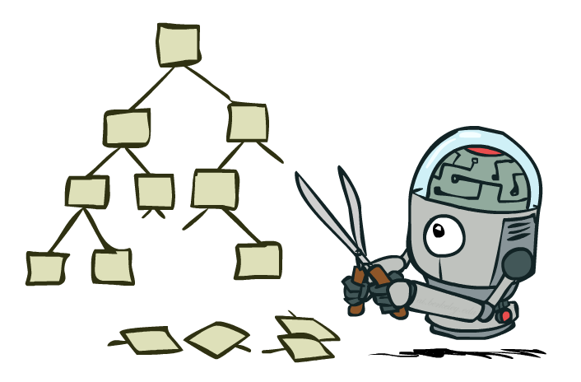
Game Tree Pruning

Slide 18
Minimax Example
3
3
2
2
3
12
8
2
4
6
14
5
2
Notes:
Add values by hand if on tablet, or add by animation steps

Slide 19
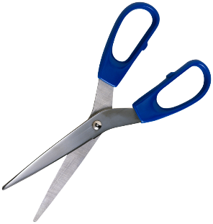
Alpha-Beta Example
α = best option so far from any
MAX node on this path
3
α =3
α =3
3
3
12
8
2
14
5
2
The order of generation matters: more
pruning is possible if good moves come first
Notes:
Add values by hand if on tablet, or add by animation steps

Slide 20
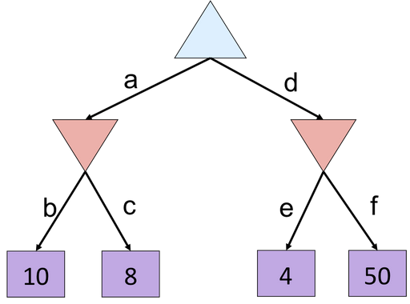
Alpha-Beta Quiz
Notes:
f is not evaluated

Slide 21
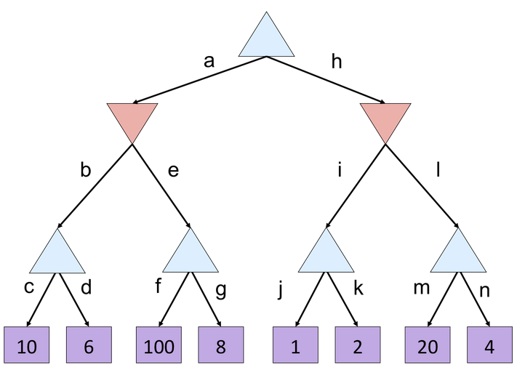
Alpha-Beta Quiz 2
Notes:
g, m, n not evaluated

Slide 22
Alpha-Beta Quiz 2
α =
10
?
β =
10
β =
2
?
?
1
2
α=
α=
10
α=
100
?
?
?

Slide 23
Alpha-Beta Pruning
General case (pruning children of MIN node)
We’re computing the MIN-VALUE at some node n
We’re looping over n’s children
n’s estimate of the childrens’ min is dropping
Who cares about n’s value? MAX
Let α be the best value that MAX can get so far at any choice point along the current path from the root
If n becomes worse than α, MAX will avoid it, so we can prune n’s other children (it’s already bad enough that it won’t be played)
Pruning children of MAX node is symmetric
Let β be the best value that MIN can get so far at any choice point along the current path from the root
MAX
MIN
a
MAX
MIN
n

Slide 24
Alpha-Beta Implementation
α: MAX’s best option on path to root
β: MIN’s best option on path to root
def max-value(state, α, β):
initialize v = -∞
for each successor of state:
v = max(v, min-value(successor, α,β))
if v ≥ β
return v
α = max(α, v)
return v
def min-value(state , α, β):
initialize v = +∞
for each successor of state:
v = min(v, max-value(successor, α, β))
if v ≤ α
return v
β = min(β, v)
return v
Notes:
Pick an order for two reasons: sequential processor and pruning

Slide 25
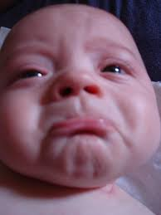
Alpha-Beta Pruning Properties
Theorem: This pruning has no effect on minimax value computed for the root!
Good child ordering improves effectiveness of pruning
Iterative deepening helps with this
With “perfect ordering”:
Time complexity drops to O(b^{m/2})
Doubles solvable depth!
This is a simple example of metareasoning (reasoning about reasoning)
For chess: only 35⁵⁰ instead of 35¹⁰⁰!! Yaaay!!!!!
max
min
10
10
0

Slide 26
Summary
Games are decision problems with ≥ 2 agents
Huge variety of issues and phenomena depending on details of interactions and payoffs
For zero-sum games, optimal decisions defined by minimax
Simple extension to n-player “rotating” max with vectors of utilities
Implementable as a depth-first traversal of the game tree
Time complexity O(b^{m}), space complexity O(bm)
Alpha-beta pruning
Preserves optimal choice at the root
Alpha/beta values keep track of best obtainable values from any max/min nodes on path from root to current node
Time complexity drops to O(b^{m/2}) with ideal node ordering
Exact solution is impossible even for “small” games like chess

