Slide 1
Chapter 3
Signal Degradation in
Optical Fibers

Slide 2
Signal Attenuation & Distortion in
Optical Fibers
What are the loss or signal attenuation mechanism in a fiber?
Why & to what degree do optical signals get distorted as they propagate down a fiber?
Signal attenuation (fiber loss) largely determines the maximum repeaterless separation between optical transmitter & receiver.
Signal distortion cause that optical pulses to broaden as they travel along a fiber, the overlap between neighboring pulses, creating errors in the receiver output, resulting in the limitation of information-carrying capacity of a fiber.

Slide 3
Attenuation (fiber loss)
Power loss along a fiber:
The parameter is called fiber attenuation coefficient in a units of for example [1/km] or [nepers/km]. A more common unit is [dB/km] that is defined by:
Z=0
P(0) mW
Z= l
mw
[3-1]
[3-2]

Slide 4
Fiber loss in dB/km
Where [dBm] or dB milliwat is 10log(P [mW]).
z=0
Z=l
[3-3]

Slide 5
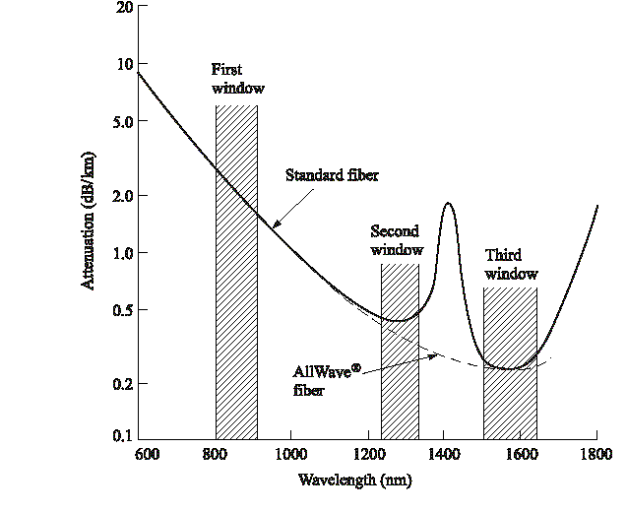
Optical fiber attenuation vs. wavelength
Optical Fiber communications, 3rd ed.,G.Keiser,McGrawHill, 2000

Slide 6
Absorption
Absorption is caused by three different mechanisms:
1- Impurities in fiber material: from transition metal ions (must be in order of ppb) & particularly from OH ions with absorption peaks at wavelengths 2700 nm, 400 nm, 950 nm & 725nm.
2- Intrinsic absorption (fundamental lower limit): electronic absorption band (UV region) & atomic bond vibration band (IR region) in basic SiO2.
3- Radiation defects

Slide 7
Scattering Loss
Small (compared to wavelength) variation in material density, chemical composition, and structural inhomogeneity scatter light in other directions and absorb energy from guided optical wave.
The essential mechanism is the Rayleigh scattering. Since the black body radiation classically is proportional to (this is true for wavelength typically greater than 5 micrometer), the attenuation coefficient due to Rayleigh scattering is approximately proportional to . This seems to me not precise, where the attenuation of fibers at 1.3 & 1.55 micrometer can be exactly predicted with Planck’s formula & can not be described with Rayleigh-Jeans law. Therefore I believe that the more accurate formula for scattering loss is

Slide 8
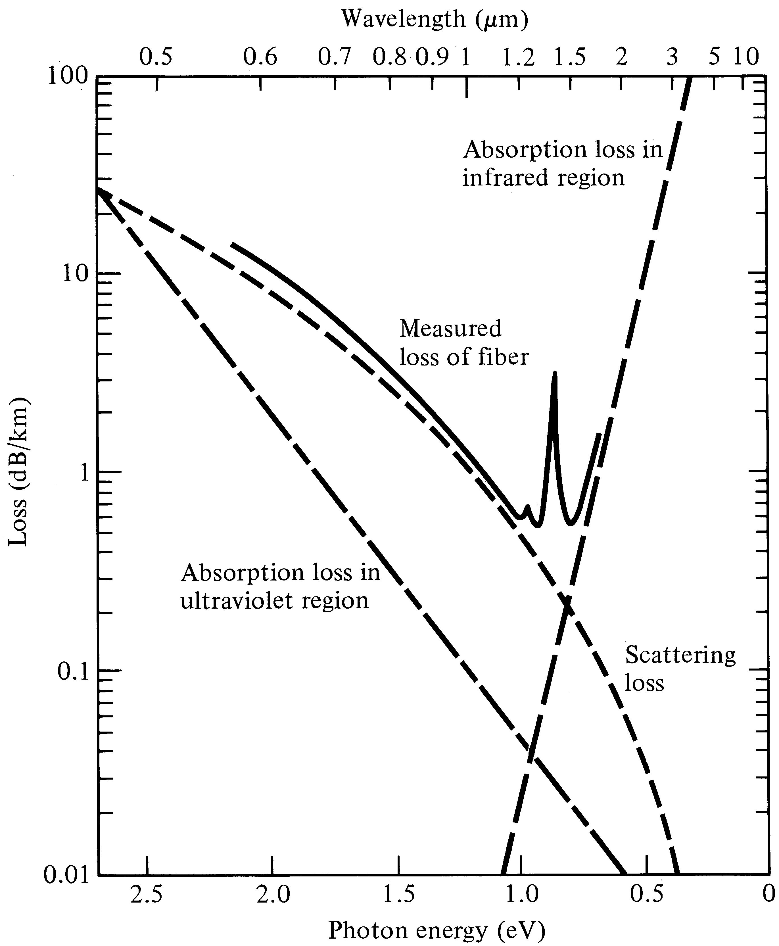
Absorption & scattering losses in fibers
Optical Fiber communications, 3rd ed.,G.Keiser,McGrawHill, 2000

Slide 9
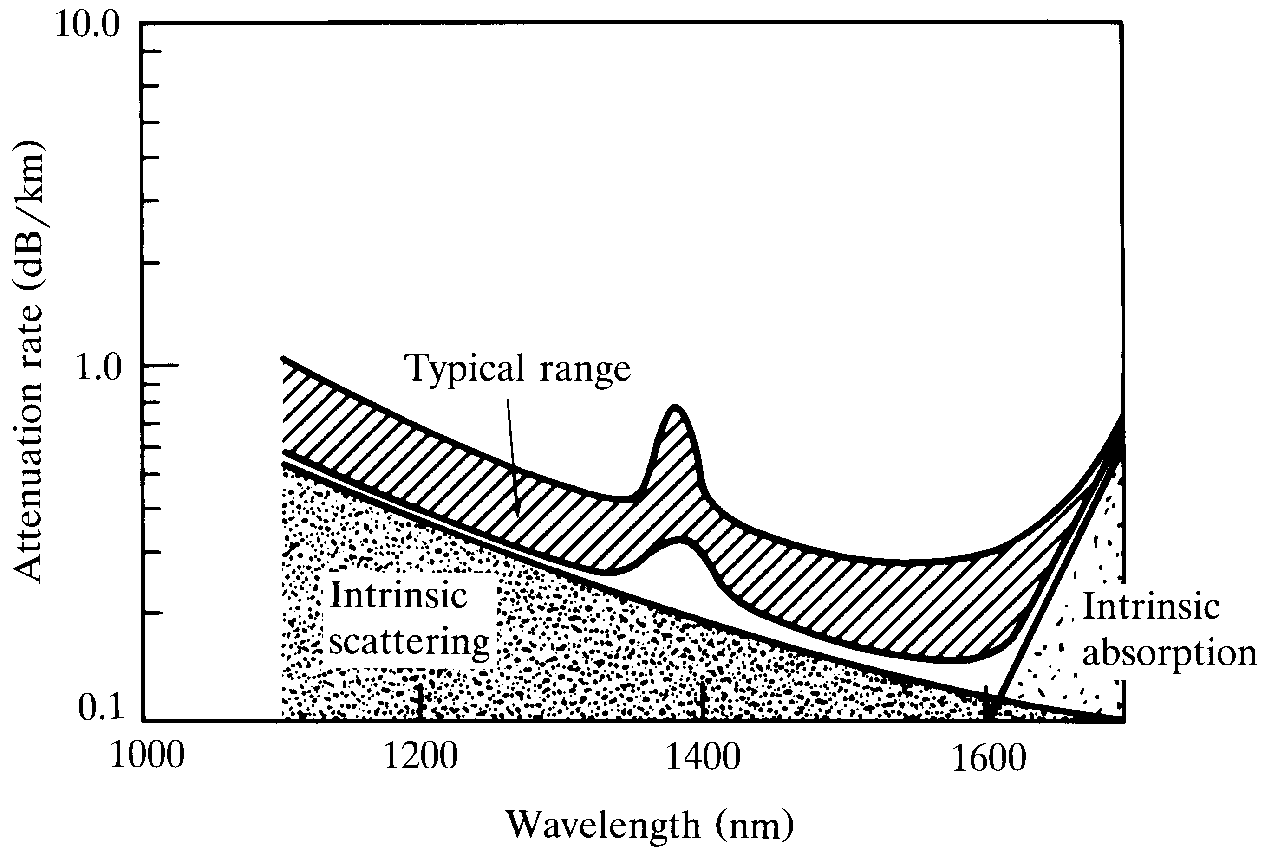
Typical spectral absorption & scattering attenuations for a single mode-fiber
Optical Fiber communications, 3rd ed.,G.Keiser,McGrawHill, 2000

Slide 10
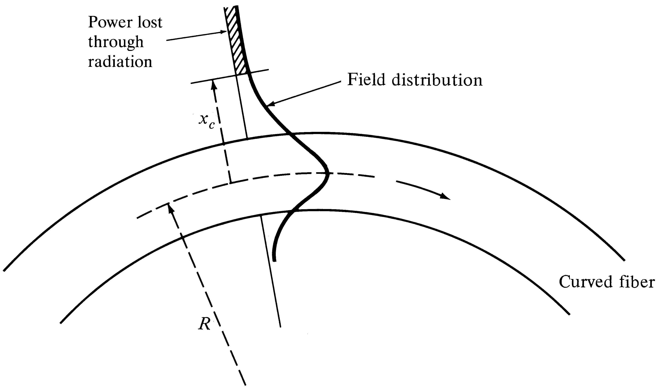
Bending Loss (Macrobending & Microbending)
Macrobending Loss: The curvature of the bend is much larger than fiber diameter. Lightwave suffers sever loss due to radiation of the evanescent field in the cladding region. As the radius of the curvature decreases, the loss increases exponentially until it reaches at a certain critical radius. For any radius a bit smaller than this point, the losses suddenly becomes extremely large. Higher order modes radiate away faster than lower order modes.
Optical Fiber communications, 3rd ed.,G.Keiser,McGrawHill, 2000

Slide 11
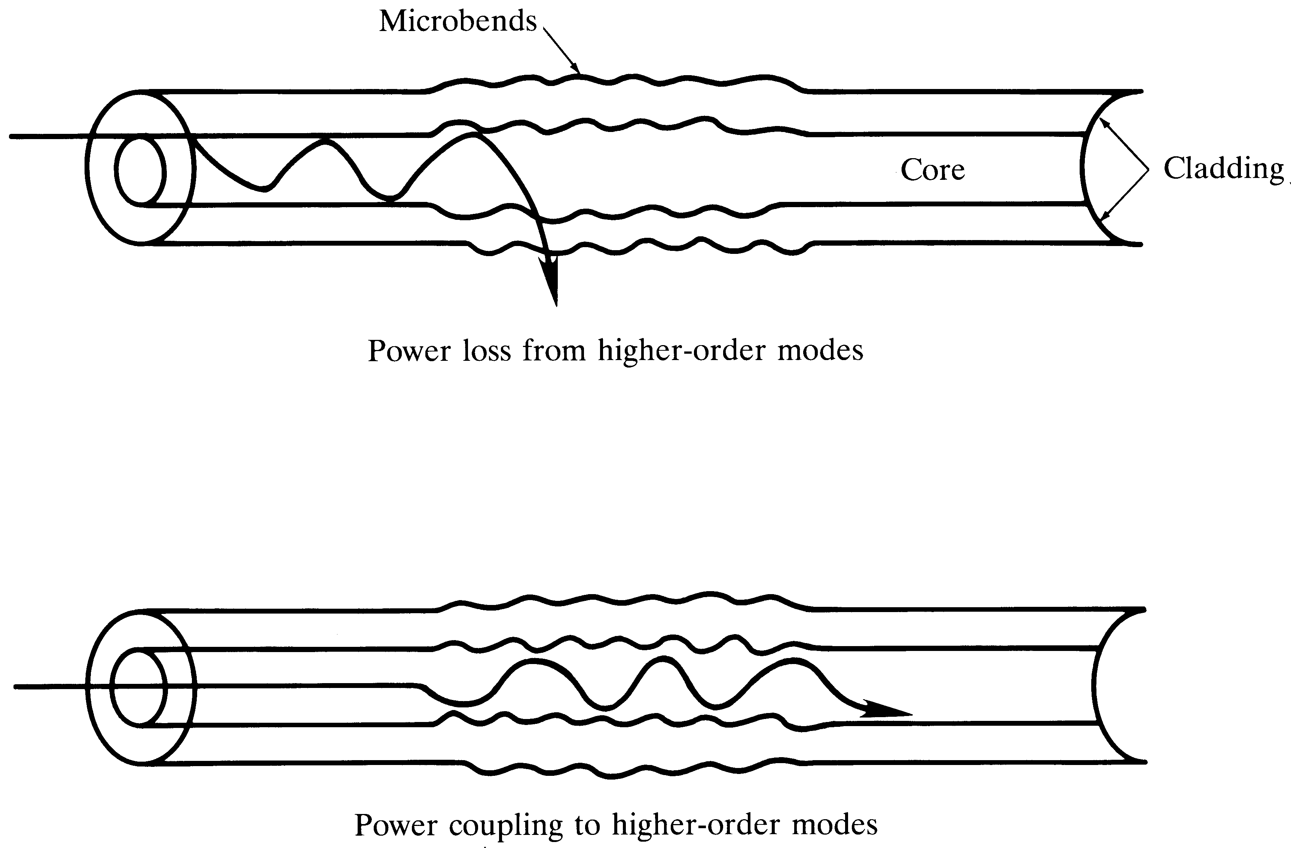
Microbending Loss
Microbending Loss: microscopic bends of the fiber axis that can arise when the fibers are incorporated into cables. The power is dissipated through the microbended fiber, because of the repetitive coupling of energy between guided modes & the leaky or radiation modes in the fiber.
Optical Fiber communications, 3rd ed.,G.Keiser,McGrawHill, 2000

Slide 12
Dispersion in Optical Fibers
Dispersion: Any phenomenon in which the velocity of propagation of any electromagnetic wave is wavelength dependent.
In communication, dispersion is used to describe any process by which any electromagnetic signal propagating in a physical medium is degraded because the various wave characteristics (i.e., frequencies) of the signal have different propagation velocities within the physical medium.
There are 3 dispersion types in the optical fibers, in general:
1- Material Dispersion
2- Waveguide Dispersion
3- Polarization-Mode Dispersion
Material & waveguide dispersions are main causes of Intramodal Dispersion.

Slide 13
Group Velocity
Wave Velocities:
1- Plane wave velocity: For a plane wave propagating along z-axis in an unbounded homogeneous region of refractive index , which is represented by , the velocity of constant phase plane is:
2- Modal wave phase velocity: For a modal wave propagating along z-axis represented by , the velocity of constant phase plane is:
3- For transmission system operation the most important & useful type of velocity is the group velocity, . This is the actual velocity which the signal information & energy is traveling down the fiber. It is always less than the speed of light in the medium. The observable delay experiences by the optical signal waveform & energy, when traveling a length of l along the fiber is commonly referred to as group delay.
[3-4]
[3-5]

Slide 14
Group Velocity & Group Delay
The group velocity is given by:
The group delay is given by:
It is important to note that all above quantities depend both on frequency & the propagation mode. In order to see the effect of these parameters on group velocity and delay, the following analysis would be helpful.
[3-6]
[3-7]

Slide 15
Input/Output signals in Fiber Transmission System
The optical signal (complex) waveform at the input of fiber of length l is f(t). The propagation constant of a particular modal wave carrying the signal is . Let us find the output signal waveform g(t).
z-=0
Z=l
[3-8]
[3-9]

Slide 16
[3-10]
[3-11]
[3-14]

Slide 17
Intramodal Dispersion
As we have seen from Input/output signal relationship in optical fiber, the output is proportional to the delayed version of the input signal, and the delay is inversely proportional to the group velocity of the wave. Since the propagation constant, , is frequency dependent over band width sitting at the center frequency , at each frequency, we have one propagation constant resulting in a specific delay time. As the output signal is collectively represented by group velocity & group delay this phenomenon is called intramodal dispersion or Group Velocity Dispersion (GVD). This phenomenon arises due to a finite bandwidth of the optical source, dependency of refractive index on the wavelength and the modal dependency of the group velocity.
In the case of optical pulse propagation down the fiber, GVD causes pulse broadening, leading to Inter Symbol Interference (ISI).

Slide 18
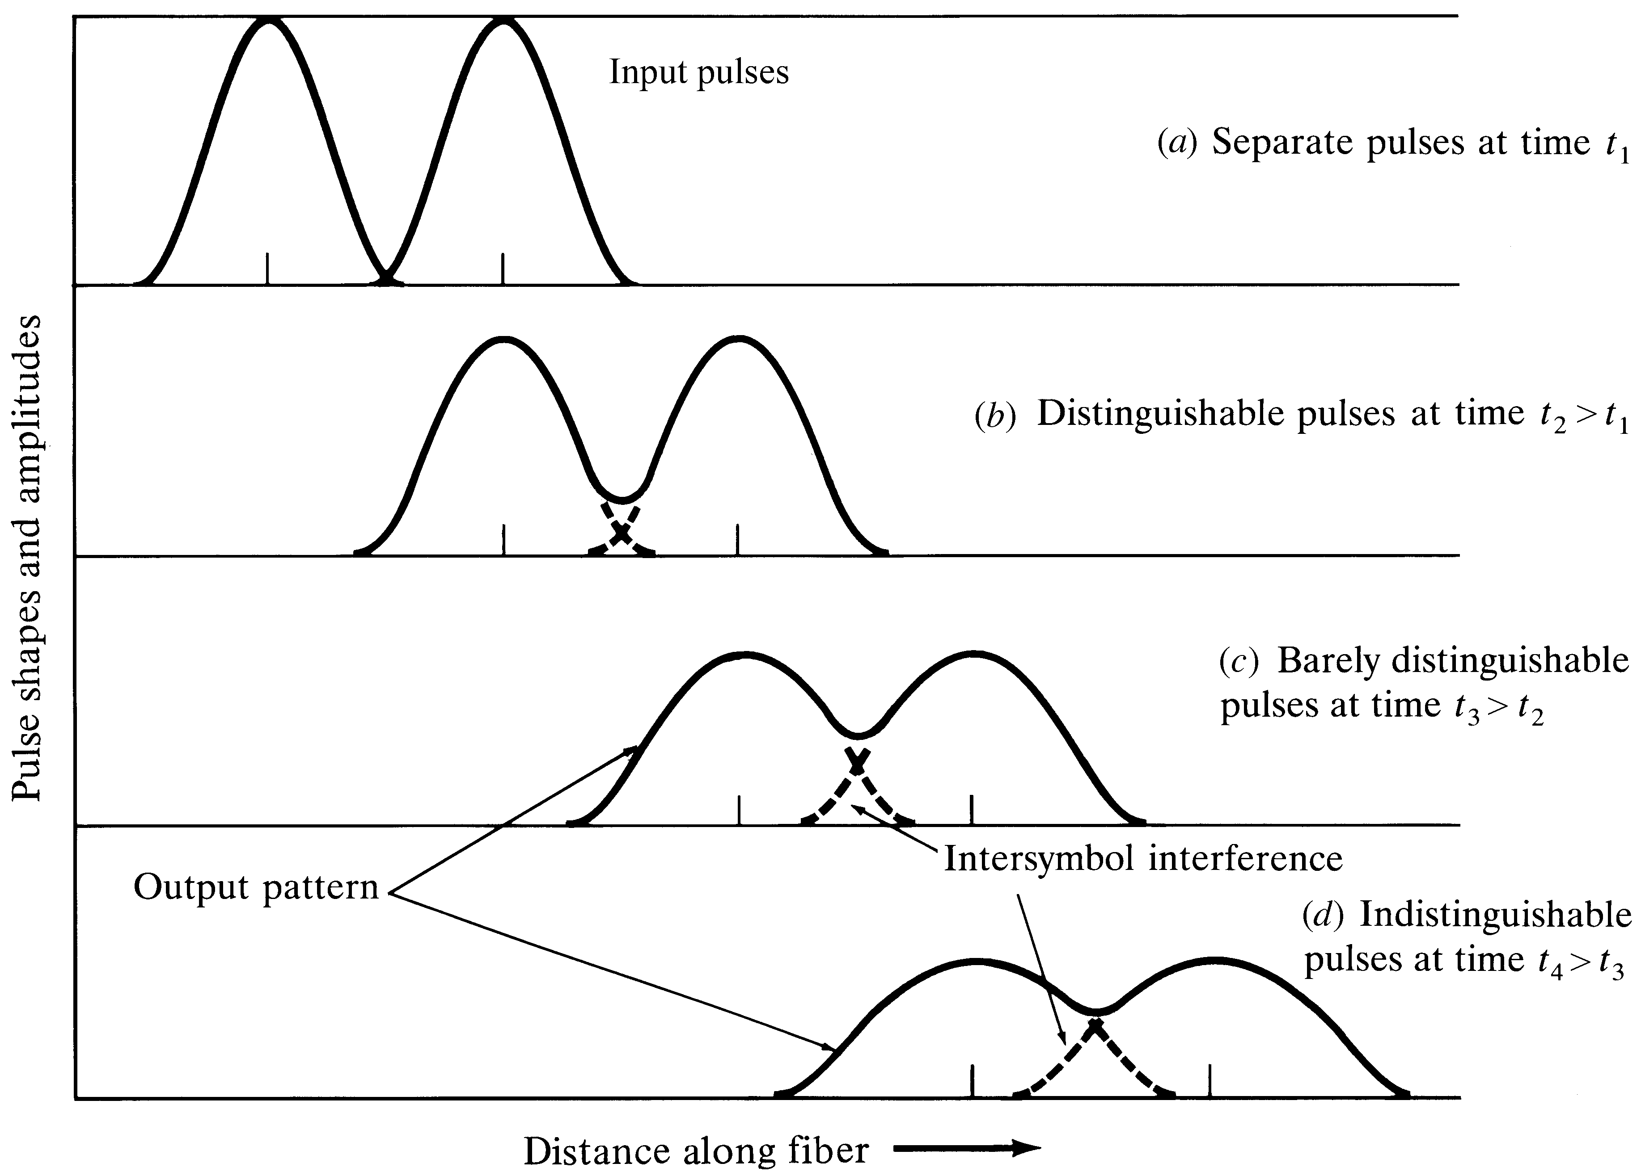
Dispersion & ISI
A measure of information capacity of an optical fiber for digital transmission is usually specified by the bandwidth distance product
in GHz.km.
For multi-mode step index fiber this quantity is about 20 MHz.km, for graded index fiber is about 2.5 GHz.km & for single mode fibers are higher than 10 GHz.km.
Optical Fiber communications, 3rd ed.,G.Keiser,McGrawHill, 2000

Slide 19
How to characterize dispersion?
Group delay per unit length can be defined as:
If the spectral width of the optical source is not too wide, then the delay difference per unit wavelength along the propagation path is approximately For spectral components which are apart, symmetrical around center wavelength, the total delay difference over a distance L is:
[3-15]
[3-16]

Slide 20
is called GVD parameter, and shows how much a light pulse broadens as it travels along an optical fiber. The more common parameter is called Dispersion, and can be defined as the delay difference per unit length per unit wavelength as follows:
In the case of optical pulse, if the spectral width of the optical source is characterized by its rms value of the Gaussian pulse , the pulse spreading over the length of L, can be well approximated by:
D has a typical unit of [ps/(nm.km)].
[3-17]
[3-18]

Slide 21
Material Dispersion

Slide 22
Material Dispersion
The refractive index of the material varies as a function of wavelength,
Material-induced dispersion for a plane wave propagation in homogeneous medium of refractive index n:
The pulse spread due to material dispersion is therefore:
[3-19]
[3-20]
is material dispersion

Slide 23
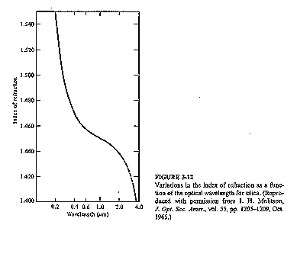
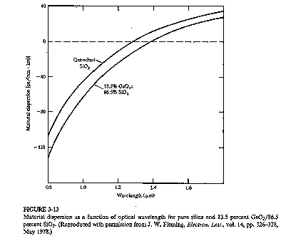
Material Dispersion Diagrams
Optical Fiber communications, 3rd ed.,G.Keiser,McGrawHill, 2000

Slide 24
Waveguide Dispersion
Waveguide dispersion is due to the dependency of the group velocity of the fundamental mode as well as other modes on the V number, (see Fig 2-18 of the textbook). In order to calculate waveguide dispersion, we consider that n is not dependent on wavelength. Defining the normalized propagation constant b as:
solving for propagation constant:
Using V number:
[3-21]
[3-22]
[3-23]

Slide 25
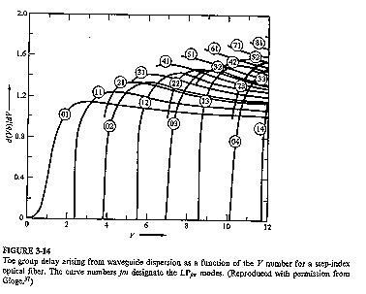
Waveguide Dispersion
Delay time due to waveguide dispersion can then be expressed as:
[3-24]
Optical Fiber communications, 3rd ed.,G.Keiser,McGrawHill, 2000

Slide 26
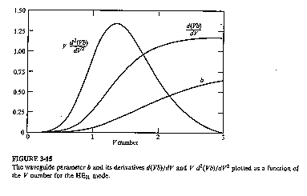
Waveguide dispersion in single mode fibers
For single mode fibers, waveguide dispersion is in the same order of material dispersion. The pulse spread can be well approximated as:
[3-25]
Optical Fiber communications, 3rd ed.,G.Keiser,McGrawHill, 2000

Slide 27
Polarization Mode dispersion

Slide 28
Polarization Mode dispersion
The effects of fiber-birefringence on the polarization states of an optical are another source of pulse broadening. Polarization mode dispersion (PMD) is due to slightly different velocity for each polarization mode because of the lack of perfectly symmetric & anisotropicity of the fiber. If the group velocities of two orthogonal polarization modes are then the differential time delay between these two polarization over a distance L is
The rms value of the differential group delay can be approximated as:
[3-26]
[3-27]

Slide 29
Chromatic & Total Dispersion
Chromatic dispersion includes the material & waveguide dispersions.
Total dispersion is the sum of chromatic , polarization dispersion and other dispersion types and the total rms pulse spreading can be approximately written as:
[3-28]
[3-29]

Slide 30
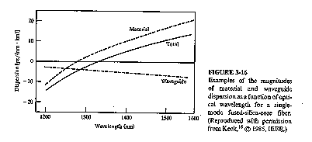
Total Dispersion, zero Dispersion
Fact 1) Minimum distortion at wavelength about 1300 nm for single mode silica fiber.
Fact 2) Minimum attenuation is at 1550 nm for sinlge mode silica fiber.
Strategy: shifting the zero-dispersion to longer wavelength for minimum attenuation and dispersion.
Optical Fiber communications, 3rd ed.,G.Keiser,McGrawHill, 2000

Slide 31
Optimum single mode fiber & distortion/attenuation characteristics
Fact 1) Minimum distortion at wavelength about 1300 nm for single mode silica fiber.
Fact 2) Minimum attenuation is at 1550 nm for single mode silica fiber.
Strategy: shifting the zero-dispersion to longer wavelength for minimum attenuation and dispersion by Modifying waveguide dispersion by changing from a simple step-index core profile to more complicated profiles. There are four major categories to do that:
1- 1300 nm optimized single mode step-fibers: matched cladding (mode diameter 9.6 micrometer) and depressed-cladding (mode diameter about 9 micrometer)
2- Dispersion shifted fibers.
3- Dispersion-flattened fibers.
4- Large-effective area (LEA) fibers (less nonlinearities for fiber optical amplifier applications, effective cross section areas are typically greater than 100 ).

Slide 32
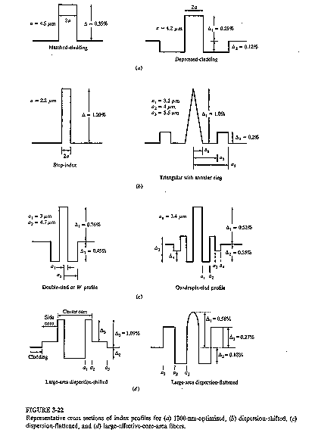

Slide 33
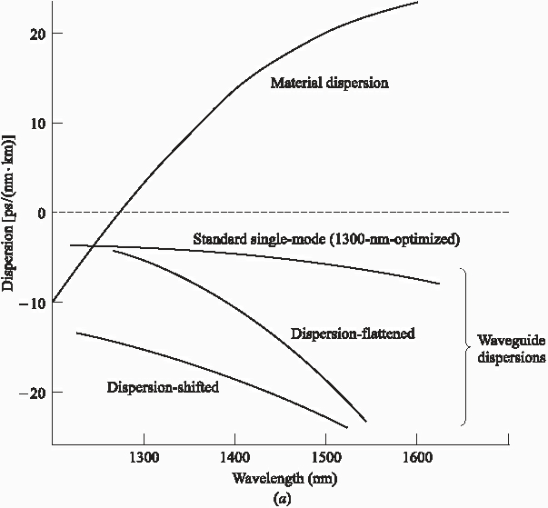
Single mode fiber dispersion
Optical Fiber communications, 3rd ed.,G.Keiser,McGrawHill, 2000

Slide 34
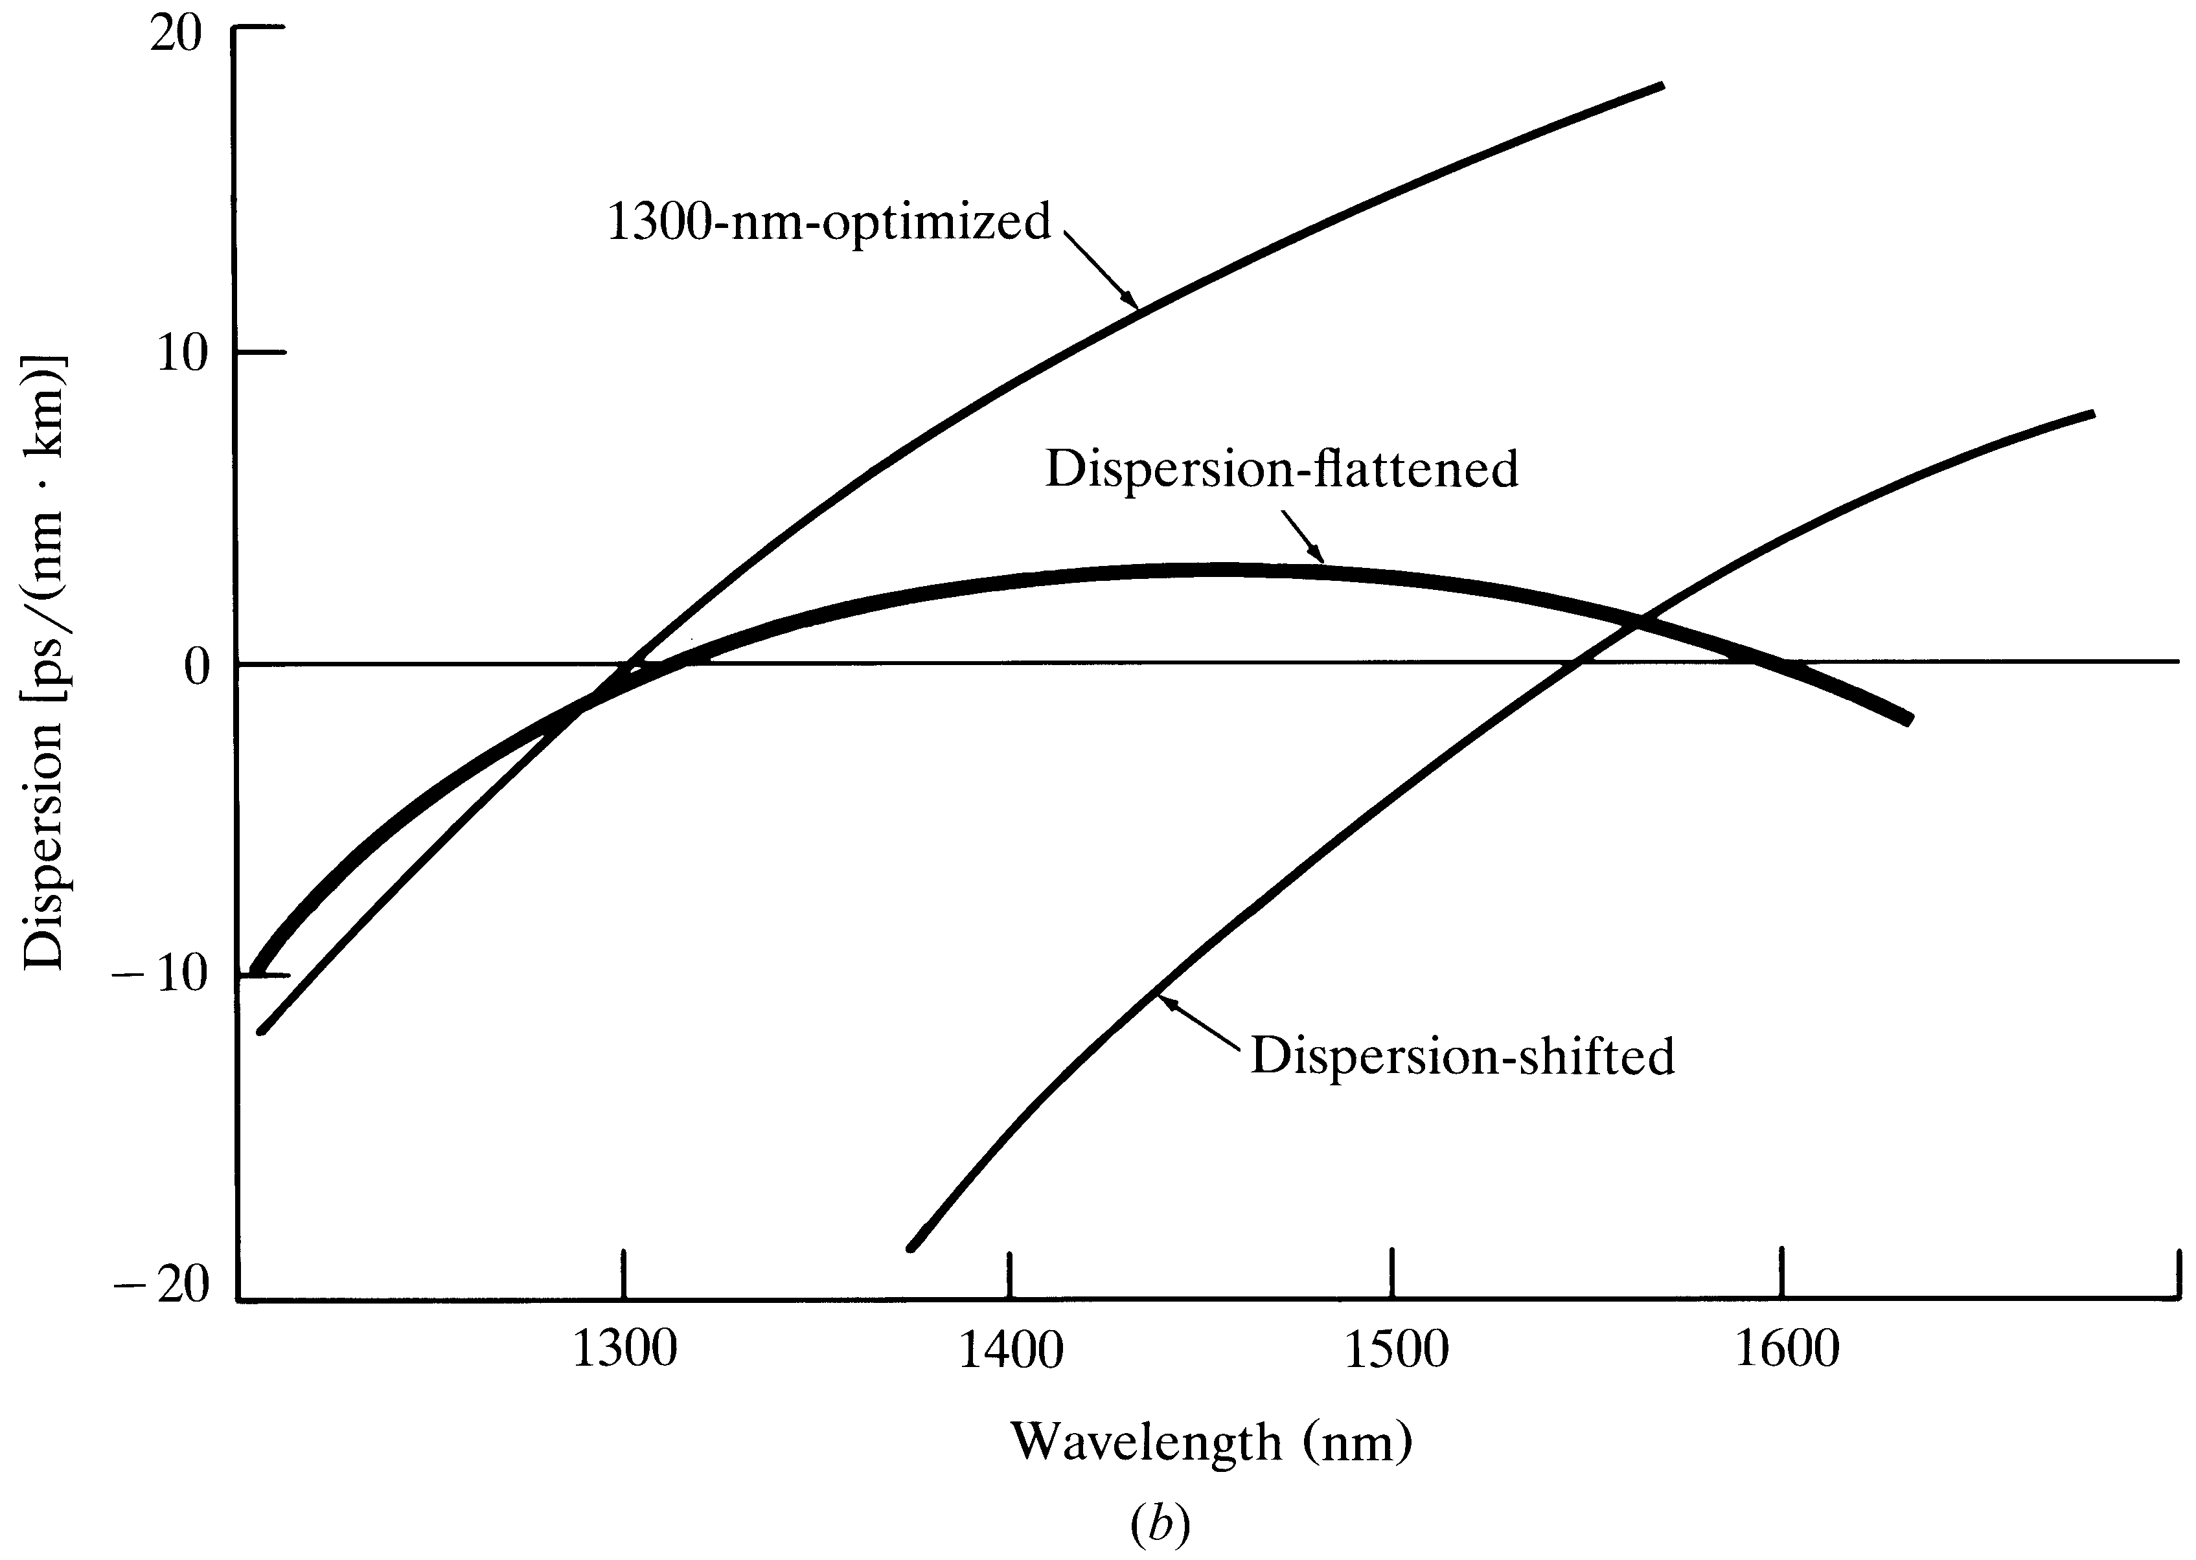
Single mode fiber dispersion
Optical Fiber communications, 3rd ed.,G.Keiser,McGrawHill, 2000

Slide 35
Single mode Cut-off wavelength & Dispersion
Fundamental mode is with V=2.405 and
Dispersion:
For non-dispersion-shifted fibers (1270 nm – 1340 nm)
For dispersion shifted fibers (1500 nm- 1600 nm)
[3-30]
[3-31]
[3-32]

Slide 36
Dispersion for non-dispersion-shifted fibers
(1270 nm – 1340 nm)
is relative delay minimum at the zero-dispersion wavelength , and is the value of the dispersion slope in .
[3-33]
[3-34]
[3-35]

Slide 37
Dispersion for dispersion shifted fibers (1500 nm- 1600 nm)
[3-36]
[3-37]

Slide 38
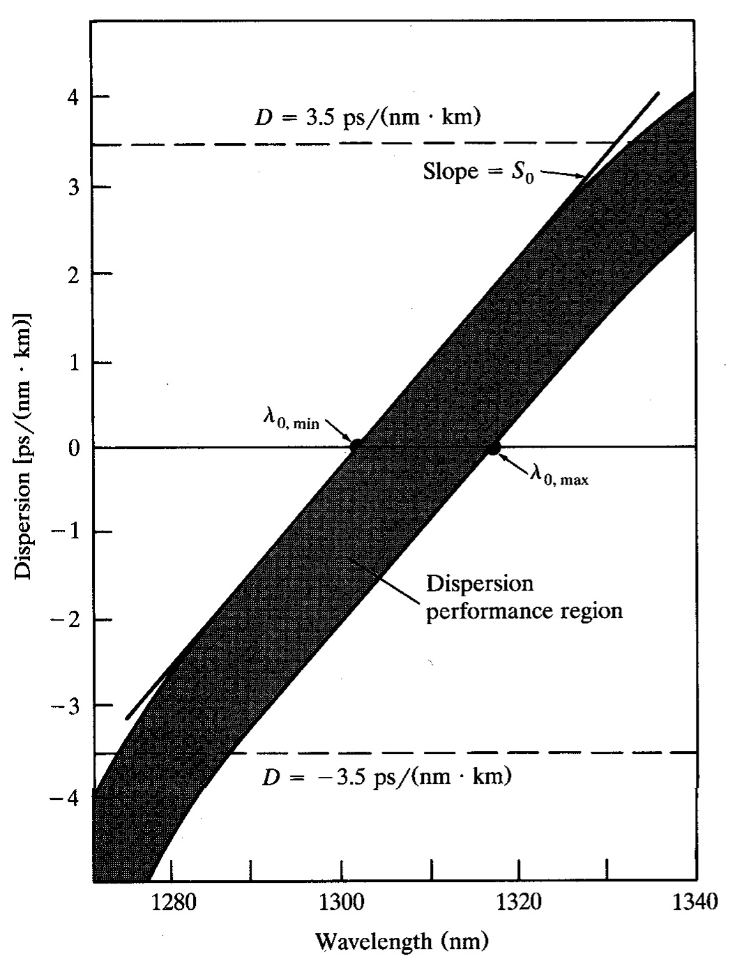
Example of dispersion
Performance curve for
Set of SM-fiber
Optical Fiber communications, 3rd ed.,G.Keiser,McGrawHill, 2000

Slide 39
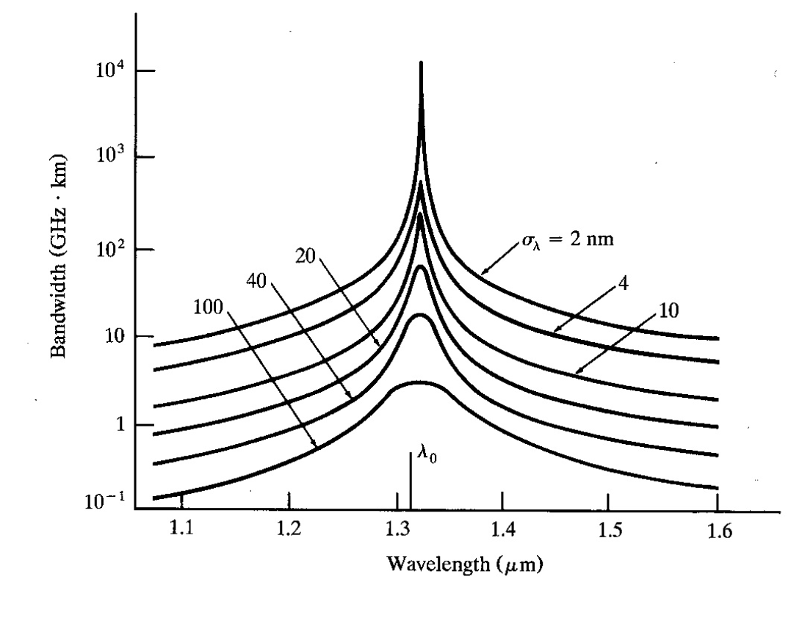
Example of BW vs wavelength for various optical sources for
SM-fiber.
Optical Fiber communications, 3rd ed.,G.Keiser,McGrawHill, 2000

Slide 40
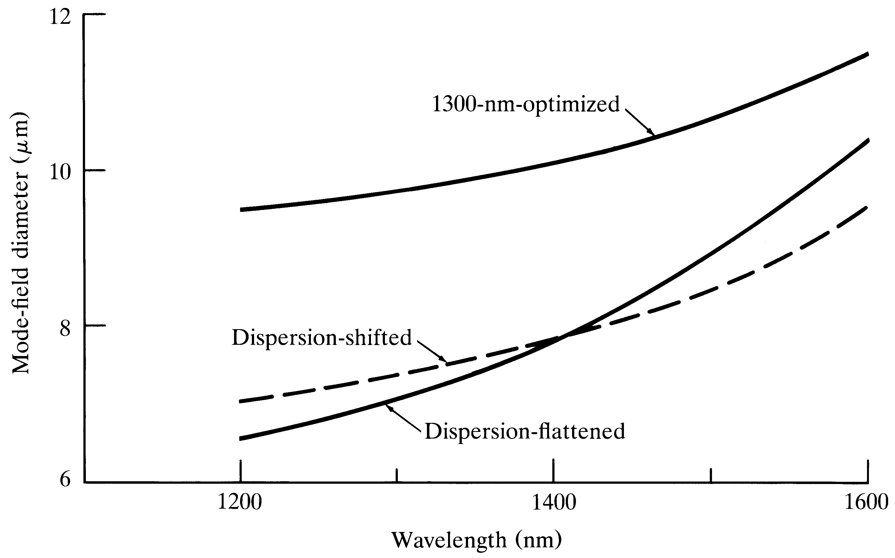
MFD
Optical Fiber communications, 3rd ed.,G.Keiser,McGrawHill, 2000

Slide 41
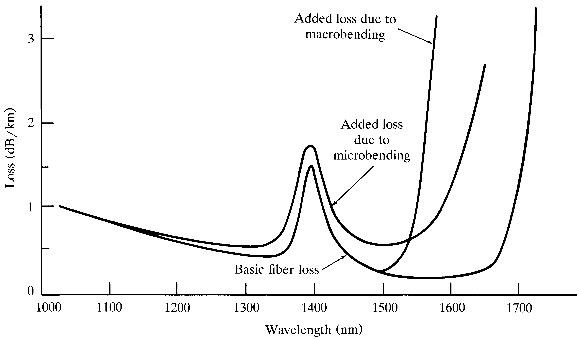
Bending Loss
Optical Fiber communications, 3rd ed.,G.Keiser,McGrawHill, 2000

Slide 42
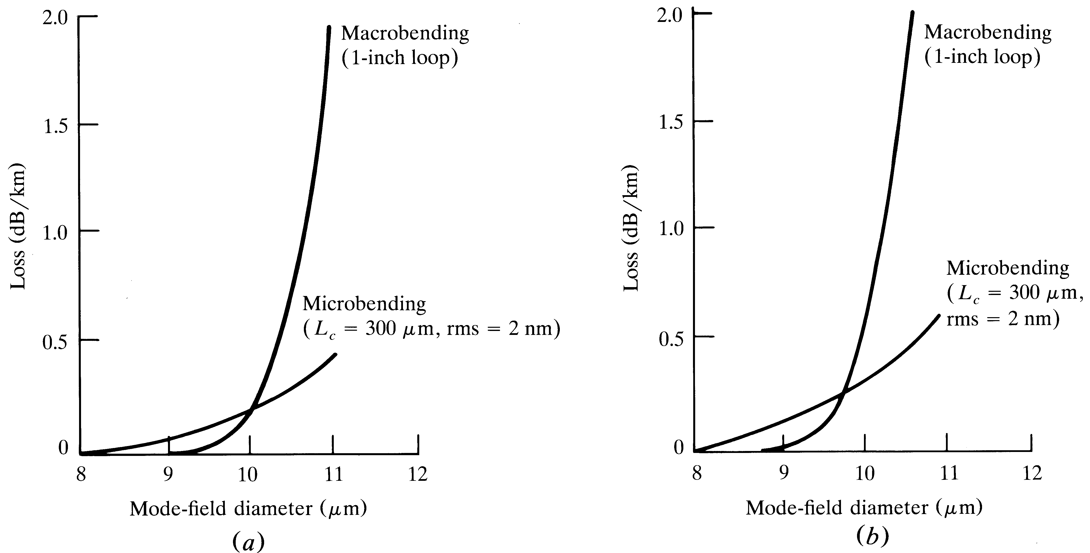
Bending effects on loss vs MFD
Optical Fiber communications, 3rd ed.,G.Keiser,McGrawHill, 2000

Slide 43
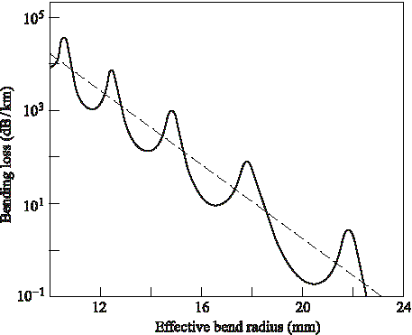
Bend loss versus bend radius
Optical Fiber communications, 3rd ed.,G.Keiser,McGrawHill, 2000

Slide 45
Temporal changes in a medium with Kerr nonlinearity and negative GVD. Since dispersion tends to broaden the pulse, Kerr
Nonlinearity tends to squeeze the pulse, resulting in a formation of optical soliton.

